Slide 1




SUMMARY

Slide 2



TRAINING
DATASET
ALONG WITH TESTING
this model is developed for predicting variable length B-cell epitopes. It is developed on LBtope_Variable dataset that contain 14876 unique
B-cell epitopes and 23321 unique non B-cellepitopes. These epitopes and non-epitopes have variable length.
all the common epitopes in both the datasets are removed and also the epitopes having length less than 5 and greater than 50 are removed.
REFERENCE :
B Cell Epitopes
Non B Cell Epitopes

Slide 3
This model developed on LBtop_Confirm dataset which contain only those epitopes or non-epitopes that have been experimentally validated by two or more studies. This dataset Lbtope_Confirm contain 1042 unique B-cell epitopes and 1795 unique non B-cell epitopes.
VALIDATION
DATASET
REFERENCE :
B Cell Epitopes
Non B Cell Epitopes

Slide 4
Contents:
method 1: support vector machine
method 2: XGboost
method 3: decision tree classifier
method 4: RNN (Recurrent neural network)
method 5: CNN (Convolutional neural network)
method 6 : CNN WITH KFOLD -5,10
method 7: Amino acid composition(AAC)
method 8: Dipeptide composition(DPC) -1,2
method 9: Voting Classifier
method 10: BERT

Slide 5



METHOD -1 : SUPPORT VECTOR MACHINE
METHODOLOGY
Using TF-IDF Vectorizer (which converts all the sequences to numerical features)
split the dataset into training and testing - LBtope variable
vectorize the x_train(fit and transform) and x_test(transform)
other parameters:
kernel - linear
METRICS
Accuracy score, mathews correlation coefficient ,recall, precision, f1score
ROC curve

Slide 6

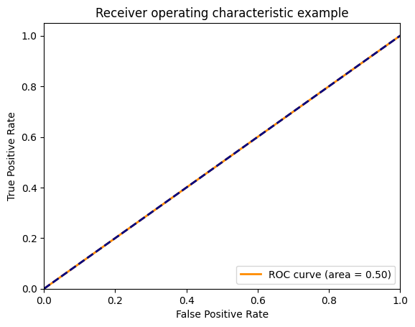
Results: Testing data
LBtope-vairable
Accuracy: 0.6100785340314137
precision recall f1-score support
negative 0.61 1.00 0.76 4661
positive 0.00 0.00 0.00 2979
accuracy 0.61 7640
macro avg 0.31 0.50 0.38 7640
weighted avg 0.37 0.61 0.46 7640
this model is only memorizing the data provided but not learning the features from it

Slide 7
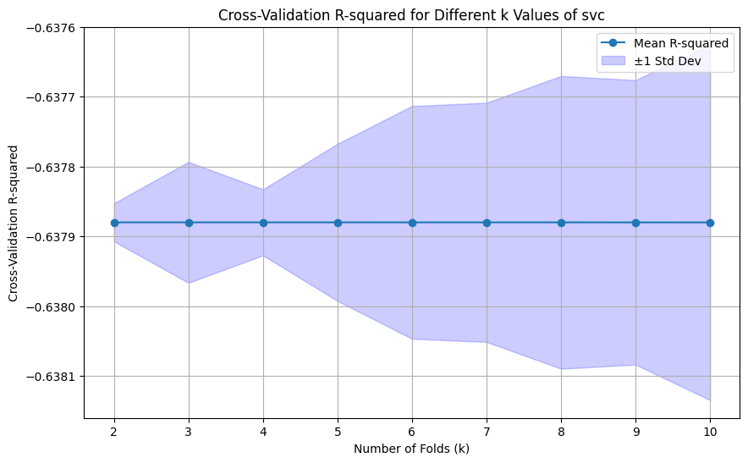

Slide 8
using tokenisation
Validation with AAV DATA
Accuracy: 0.07065217391304347
array([[ 0, 0],
[171, 13]])
precision recall f1-score support
0 0.00 0.00 0.00 0
1 1.00 0.07 0.13 184
accuracy 0.07 184
macro avg 0.50 0.04 0.07 184
weighted avg 1.00 0.07 0.13 184

Slide 9
using dpc
Validation with
AAV DATA
Accuracy: 0.2010869
Conf_matrix:
array([[ 0, 0],
[174, 37]])
precision recall f1-score support
0 0.00 0.00 0.00 0
1 1.00 0.20 0.33 184
accuracy 0.20 184
macro avg 0.50 0.10 0.17 184
weighted avg 1.00 0.20 0.33 184

Slide 10
INTERPRETATION:
The model is heavily biased towards predicting the negative class, failing to identify any positive instances.
The overall performance metrics indicate significant room for improvement, especially in correctly identifying positive cases.

Slide 11
METHOD - 2 : XGBOOST
METHODOLOGY
Using TF-IDF Vectorizer (which converts all the sequences to numerical features)
split the dataset into training and testing - Lbtope variable
vectorize the x_train(fit and transform) and x_test(transform)
METRICS
Accuracy score, mathews correlation coefficient ,recall, precision, f1score
ROC curve

Slide 12
Results: Testing data
LBtope-vairable
Accuracy: 0.618455497382199
precision recall f1-score support
0 0.62 1.00 0.76 4725
1 0.00 0.00 0.00 2915
accuracy 0.62 7640
macro avg 0.31 0.50 0.38 7640
weighted avg 0.38 0.62 0.47 7640

Slide 13
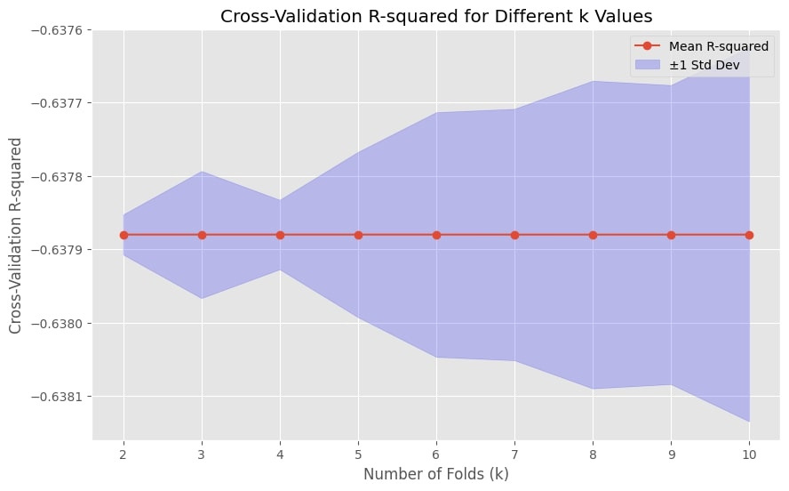
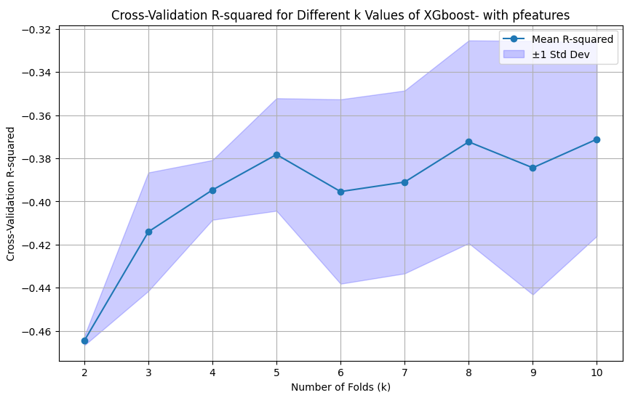

Slide 14
Xgboost with tokenisation
0
accuracy: 0.5706521739130435
array([[ 0, 0],
[ 79, 105]])
precision recall f1-score support
0 0.00 0.00 0.00 0
1 1.00 0.57 0.73 184
accuracy 0.57 184
macro avg 0.50 0.29 0.36 184
weighted avg 1.00 0.57 0.73 184
Validation with AAV DATA

Slide 15
INTERPRETATION:
The model is heavily biased towards predicting the negative class, failing to identify any positive instances.
The overall performance metrics indicate significant room for improvement, especially in correctly identifying positive cases.

Slide 16
METHOD - 3 : DECISION TREES
METHODOLOGY
Using TF-IDF Vectorizer (which converts all the sequences to numerical features)
split the dataset into training and testing - LB tope variable
vectorize the x_train(fit and transform) and x_test(transform)
METRICS
Accuracy score, mathews correlation coefficient ,recall, precision, f1score

Slide 17
Results: Testing data
LBtope-vairable
Accuracy: 0.6100785340314137
precision recall f1-score support
negative 0.61 1.00 0.76 4661
positive 0.00 0.00 0.00 2979
accuracy 0.61 7640
macro avg 0.31 0.50 0.38 7640
weighted avg 0.37 0.61 0.46 7640

Slide 18
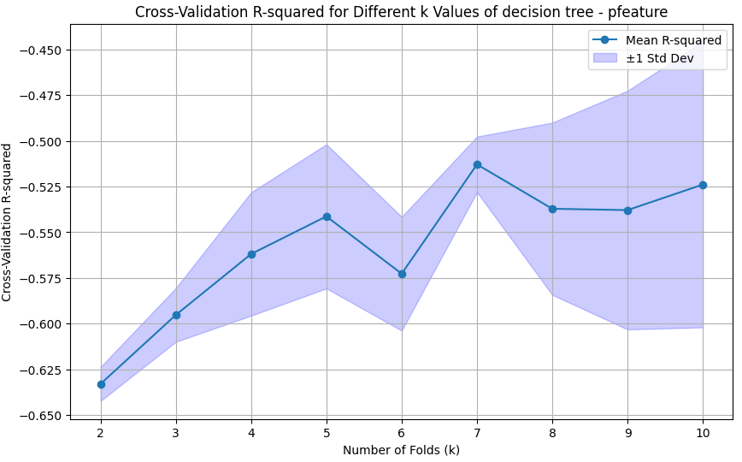

Slide 19
Validation with AAV DATA
using dpc
accuracy: 0.75
array([[ 0, 0],
[ 46, 138]])
precision recall f1-score support
0 0.00 0.00 0.00 0
1 1.00 0.75 0.86 184
accuracy 0.75 184
macro avg 0.50 0.38 0.43 184
weighted avg 1.00 0.75 0.86 184

Slide 20
using tokenisation
Validation with AAV DATA
Accuracy: 0.07065217391304347
precision recall f1-score support
0 0.00 0.00 0.00 0
1 1.00 0.07 0.13 184
accuracy 0.07 184
macro avg 0.50 0.04 0.07 184
weighted avg 1.00 0.07 0.13 184

Slide 21
INTERPRETATION:
The model is heavily biased towards predicting the negative class, failing to identify any positive instances.
The overall performance metrics indicate significant room for improvement, especially in correctly identifying positive cases.

Slide 22
METHOD - 4 : Recurrent Neural Network
METHODOLOGY
Using TF-IDF Vectorizer (which converts all the sequences to numerical features)
split the dataset into training and testing - LB tope variable
vectorize the x_train(fit and transform) and x_test(transform)
MODEL
Embedding layer - where the input dimension is the size of vocabulary plus 1 for pad ,output dimension is 16 dimensional vector
SimpleRNN (16) this layer consists of 16 units , i processes the sequence data one step at a time and maintains a hidden state

Slide 23
3. layer : a fully connected layer with 16 units and relu activation function . it processes the output from RNN layer and applies a non - linear transformation
4. Output Dense layer : the output layer with a single unit and sigmoid activation function , used for binary classification
5. loss function : binary cross entropy , optimizer: adam
METRICS
Accuracy score, mathews correlation coefficient ,recall, precision, f1score

Slide 24
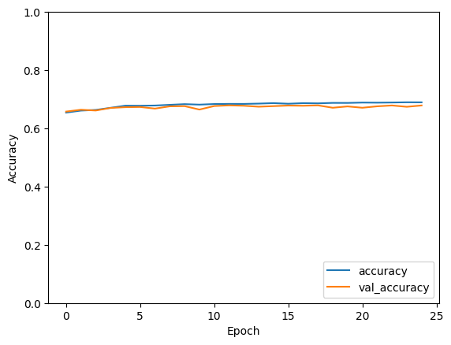
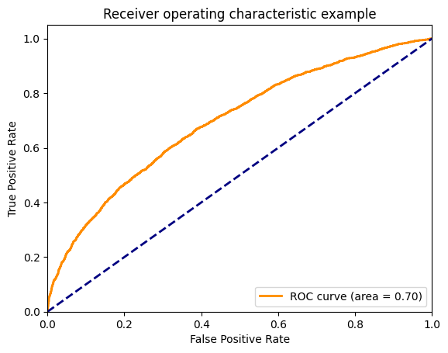
RESULTS
test
epoch vs accuracy
ROC CURVE

Slide 25
Results: Testing data
LBtope-vairable
Accuracy: 0.6663612723350525
(MCC): 0.28156001957534404
precision recall f1-score support
0 0.68 0.85 0.76 4603
1 0.64 0.40 0.49 3037
accuracy 0.67 7640
macro avg 0.66 0.62 0.62 7640
weighted avg 0.66 0.67 0.65 7640
Confusion Matrix:
[[3906 697]
[1820 1217]]

Slide 26
With Validation dataset:
LB tope fixed
Accuracy: 0.7271765949947128
(MCC): 0.38499575326462343
precision recall f1-score support
0 0.74 0.88 0.80 1795
1 0.69 0.47 0.56 1042
accuracy 0.73 2837
macro avg 0.71 0.67 0.68 2837
weighted avg 0.72 0.73 0.71 2837
array([[1577, 218],
[ 556, 486]])

Slide 27
Validation with AAV DATA
Accuracy: 0.45108695652173914
array([[ 0, 0],
[101, 83]])
precision recall f1-score support
0 0.00 0.00 0.00 0
1 1.00 0.45 0.62 184
accuracy 0.45 184
macro avg 0.50 0.23 0.31 184
weighted avg 1.00 0.45 0.62 184

Slide 28
INTERPRETATION:
he flat and similar lines for training and validation accuracy suggest that the model's learning is stagnant and it is neither improving nor overfitting. However, the accuracy level indicates that the model's performance is relatively low.
The AUC is 0.70, which means the model has a moderate ability to distinguish between the classes, performing better than random guessing but still with room for improvement.

Slide 29
METHOD - 5 : CNN
METHODOLOGY
Using TF-IDF Vectorizer (which converts all the sequences to numerical features)
split the dataset into training and testing - LB tope variable
vectorize the x_train(fit and transform) and x_test(transform)
MODEL
Embedding layer - where the input dimension is the size of vocabulary plus 1 for pad ,output dimension is 1000 dimensional vector
Convulutional layer - which has 128 filters, window size 5 and an activation function of reLU
Notes:
EDIT

Slide 30
3. Global max pooling layer : A single value per feature map (total of 128 values if the input had 128 filters)
4. Dense layer :The number of neurons in the layer (128). and The activation function applied to the output of the layer is reLU
5. Dropout layer : defines a fraction of input layers to drop -0.5
6. Output Dense layer : the output layer with a single unit and sigmoid activation function , used for binary classification
METRICS
Accuracy score, mathews correlation coefficient ,recall, precision, f1score
Notes:
EDIT

Slide 31
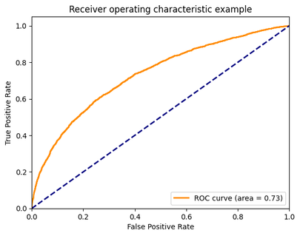
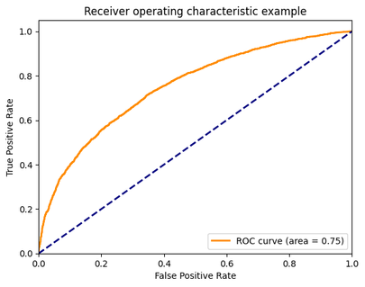
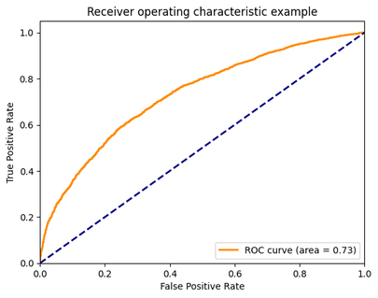
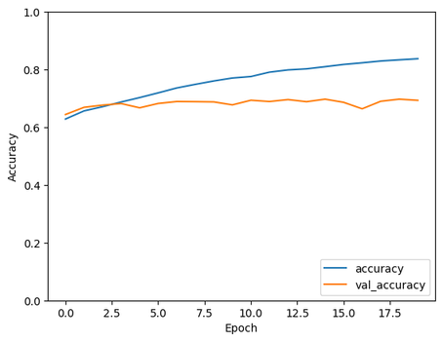
RESULTS
testing Accuracy: 0.689397931098938 epoch=15 batch_size = 32
validation Accuracy : 0.8396193161790624
testing Accuracy: 0.7065445184707642 epoch=16 batch_size = 32
validation Accuracy: 0.8403242862178357
testing Accuracy: 0.6912303566932678 epoch=20 batch_size = 32
validation Accuracy: 0.8491364117025026
testing

Slide 32
Results: Testing data
LBtope-vairable
Classification Report:
precision recall f1-score support
0 0.73 0.79 0.76 4661
1 0.62 0.53 0.57 2979
accuracy 0.69 7640
macro avg 0.67 0.66 0.67 7640
weighted avg 0.69 0.69 0.69 7640
Confusion Matrix:
[[3698 963]
[1396 1583]]
(MCC): 0.3360494589435545

Slide 33
Validation data :
LB tope fixed
MCC
0.7165044856049663
precision recall f1-score support
0 0.86 0.89 0.88 1795
1 0.80 0.74 0.77 1042
accuracy 0.84 2837
macro avg 0.83 0.82 0.82 2837
weighted avg 0.84 0.84 0.84 2837
array([[1606, 189],
[ 266, 776]])

Slide 34
RANDOM TRIES
Batchsize = 64,epoch = 100, accuracy = 69.82
batch_size=32, epochs=10 , accuracy 68.2
batch_size=32, epochs=13, accuracy 68.6
batchsize = 8, epochs = 15,accuracy = 69.06
batchsize = 8, epoch=16, accuracy = 69.86
batchsize=8, epochs=16,accuracy = 70.46
batch_size=8, epochs=18, accuracy = 71.06
batchsize = 8, epochs=21, accuracy = 71.3
batchsize=4, epochs=50, accuracy = 69.03

Slide 35
Validation with AAV DATA
Accuracy: 0.56
[ 0 0 ]
[ 81 103]
precision recall f1-score support
0 0.00 0.00 0.00 0
1 1.00 0.56 0.72 184
accuracy 0.56 184
macro avg 0.50 0.28 0.36 184
weighted avg 0.56 0.31 0.40 184

Slide 36
INTERPRETATION
The validation accuracy shows a slight increase initially but then flattens and fluctuates around 0.63.
This indicates that while the model is improving on the training data, it is not showing similar improvement on the validation data.

Slide 37
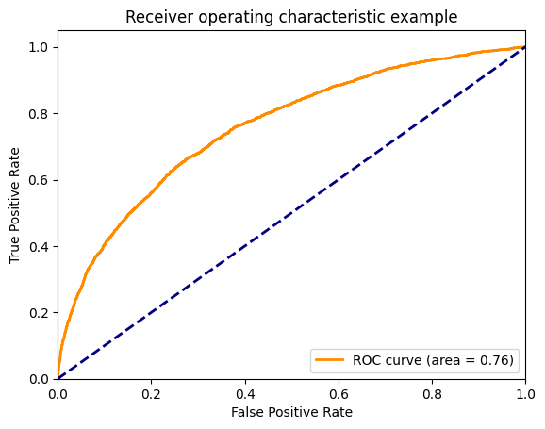
METHOD - 6 : CNN with KFold - 5
Results: Testing data
LBtope-vairable
Mean Cross-Validation Accuracy: 0.7072543501853943
(MCC): 0.3725244342365087
Classification Report:
precision recall f1-score support
0 0.74 0.80 0.77 23321
1 0.64 0.55 0.60 14876
accuracy 0.71 38197
macro avg 0.69 0.68 0.68 38197
weighted avg 0.70 0.71 0.70 38197

Slide 38
with Validation data
:Lb tope - fixed
Accuracy:0.8854423686993302
mcc: 0.7545398019978594
conf_matrix
array([[1604, 191],
[ 137, 905]])
precision recall f1-score support
0 0.91 0.91 0.91 1795
1 0.85 0.84 0.84 1042
accuracy 0.89 2837
macro avg 0.88 0.88 0.88 2837
weighted avg 0.89 0.86 0.89 2837

Slide 39
Validation with AAV DATA
accuracy: 0.4945
array([[ 0, 0],
[93, 91]])
precision recall f1-score support
0 0.00 0.00 0.00 0
1 1.00 0.49 0.66 184
accuracy 0.49 184
macro avg 0.50 0.25 0.33 184
weighted avg 1.00 0.49 0.66 184

Slide 40
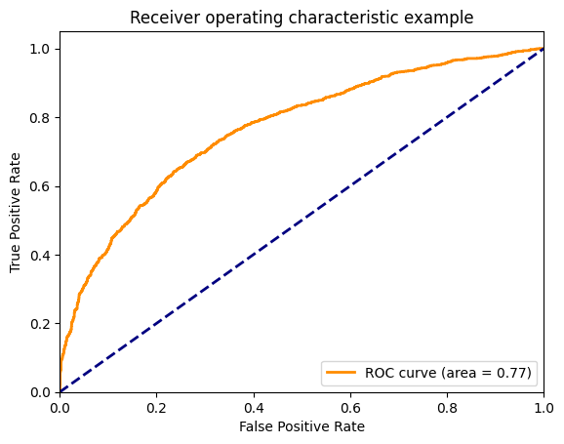
CNN with KFold - 10
Results: Testing data
LBtope-vairable
Mean Cross-Validation Accuracy:0.7143228650093079
(MCC): 0.3845715900895881
Classification Report:
precision recall f1-score support
0 0.74 0.82 0.78 23321
1 0.66 0.55 0.60 14876
accuracy 0.71 38197
macro avg 0.70 0.68 0.69 38197
weighted avg 0.71 0.71 0.71 38197

Slide 41
with Validation data : LB tope - fixed
Accuracy:0.8709904829044766
precision recall f1-score support
0 0.88 0.93 0.90 1795
1 0.86 0.77 0.81 1042
accuracy 0.87 2837
macro avg 0.87 0.85 0.86 2837
weighted avg 0.87 0.87 0.87 2837
mcc: 0.718803700
conf_matrix
array([[1665, 130],
[ 236, 806]]

Slide 42
Validation with AAV DATA
Accuracy: 0.47282608695652173
conf_matrix
array([[ 0, 0],
[97, 87]])
precision recall f1-score support
0 0.00 0.00 0.00 0
1 1.00 0.47 0.64 184
accuracy 0.47 184
macro avg 0.50 0.24 0.32 184
weighted avg 1.00 0.47 0.64 184

Slide 43
INTERPRETATION
The model shows higher precision and recall for the majority class (class 0) compared to the minority class (class 1), indicating a bias towards the majority class for cv = 5
While the model performs well, focusing on improving recall for the positive class and further tuning could enhance its performance for cv =10.

Slide 44
METHOD - 7: PFeature - AAC
METHODOLOGY
To preprocess the training dataset and extract relevant features, we employed CD-HIT for sequence clustering and redundancy removal, followed by Pfeature for feature extraction based on amino acid composition which results in 20 distinct features
the obtained features are then trained with lazyclassifier to know the best fit model for classification
METRICS
Accuracy score, mathews correlation coefficient ,recall, precision, f1score

Slide 45
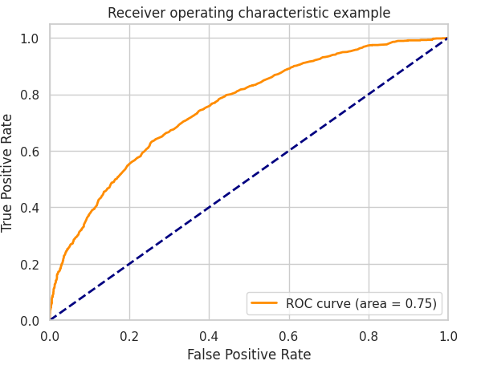
Results: Testing data
Best fit model: Extra Trees Classifier
LBtope-vairable
mcc :0.363363972584853
Accuracy: 0.6868533171028606
precision recall f1-score support
0 0.68 0.80 0.73 1779
1 0.70 0.55 0.61 1507
accuracy 0.69 3286
macro avg 0.69 0.67 0.67 3286
weighted avg 0.69 0.69 0.68 3286
array([[1429, 350],
[ 684, 823]])

Slide 46
with Validation data : LB tope - fixed
Accuracy: 0.700740218540712
mcc :0.38371043785935655
precision recall f1-score support
negative 0.79 0.71 0.75 1795
positive 0.58 0.68 0.63 1042
accuracy 0.70 2837
macro avg 0.69 0.70 0.69 2837
weighted avg 0.72 0.70 0.70 2837
array([[1275, 520],
[ 329, 713]])

Slide 47
Validation with AAV DATA
accuracy: 0.6304347826086957
array([[ 0, 0],
[ 68, 116]])
precision recall f1-score support
0 0.00 0.00 0.00 0
1 1.00 0.63 0.77 184
accuracy 0.63 184
macro avg 0.50 0.32 0.39 184
weighted avg 1.00 0.63 0.77 184

Slide 48
METHOD - 8: PFeature - DPC - 1
METHODOLOGY
To preprocess the training dataset and extract relevant features, we employed CD-HIT for sequence clustering and redundancy removal, followed by Pfeature for feature extraction based on amino acid composition which results in 400 distinct features(alternte) - gap of 1
the obtained features are then trained with lazyclassifier to know the best fit model for classification
METRICS
Accuracy score, mathews correlation coefficient ,recall, precision, f1score

Slide 49
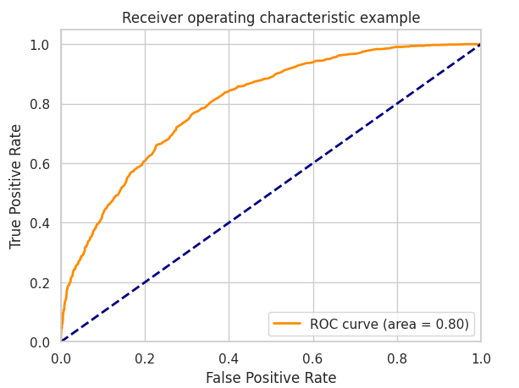
Results:
LB tope - variable
Best fit model: Random forest classifier
mcc :0.363363972584853
Accuracy: 0.7096774193548387
precision recall f1-score support
negative 0.69 0.84 0.76 1779
positive 0.74 0.56 0.64 1507
accuracy 0.71 3286
macro avg 0.72 0.70 0.70 3286
weighted avg 0.72 0.71 0.70 3286
array([[1490, 289],
[ 665, 842]])

Slide 50
with Validation data : LB tope - fixed
mcc :0.402687364
Accuracy: 0.7151921043355658
precision recall f1-score support
negative 0.79 0.74 0.77 1795
positive 0.60 0.67 0.63 1042
accuracy 0.72 2837
macro avg 0.70 0.71 0.70 2837
weighted avg 0.72 0.72 0.72 2837
array([[1333, 462],
[ 346, 696]])

Slide 51
Validation with AAV DATA
accuracy: 0.6467391304347826
array([[ 0, 0],
[ 65, 119]])
precision recall f1-score support
0 0.00 0.00 0.00 0
1 1.00 0.65 0.79 184
accuracy 0.65 184
macro avg 0.50 0.32 0.39 184
weighted avg 1.00 0.65 0.79 184

Slide 52
PFeature - DPC - 2
METHODOLOGY
To preprocess the training dataset and extract relevant features, we employed CD-HIT for sequence clustering and redundancy removal, followed by Pfeature for feature extraction based on amino acid composition which results in 400 distinct features - gap of 2
the obtained features are then trained with lazyclassifier to know the best fit model for classification
METRICS
Accuracy score, mathews correlation coefficient ,recall, precision, f1score

Slide 53
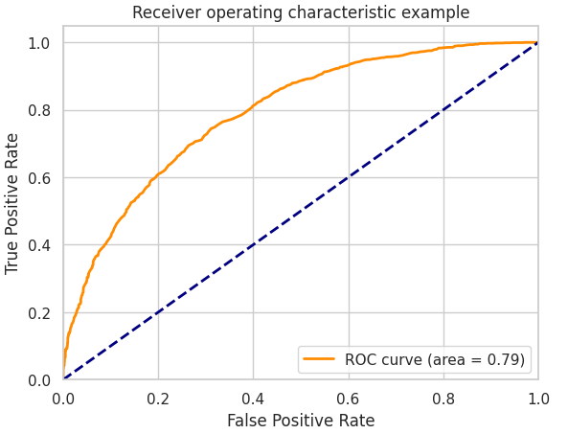
Results:
LB tope - variable
Best fit model: Extra Trees Classifier
mcc :0.4106882852918963
Accuracy: 0.7087644552647596
precision recall f1-score support
negative 0.71 0.79 0.75 1779
positive 0.71 0.61 0.66 1507
accuracy 0.71 3286
macro avg 0.71 0.70 0.70 3286
weighted avg 0.71 0.71 0.71 3286
array([[1406, 373],
[ 584, 923]])

Slide 54
with Validation data : LB tope - fixed
Accuracy: 0.697567853366232
mcc :0.36
precision recall f1-score support
negative 0.81 0.69 0.74 1795
positive 0.57 0.72 0.63 1042
accuracy 0.70 2837
macro avg 0.69 0.70 0.69 2837
weighted avg 0.72 0.70 0.70 2837
array([[1233, 562],
[ 296, 746]])

Slide 55
Validation with AAV DATA
accuracy: 0.8043478
array([[ 0, 0],
[ 36, 148]])
precision recall f1-score support
0 0.00 0.00 0.00 0
1 1.00 0.80 0.89 184
accuracy 0.80 184
macro avg 0.50 0.40 0.45 184
weighted avg 1.00 0.80 0.89 184

Slide 56
METHOD - 9: VOTING CLASSIFIER
METHODOLOGY
To preprocess the training dataset and extract relevant features, we employed CD-HIT for sequence clustering and redundancy removal, followed by Pfeature for feature extraction based on amino acid composition which results in 400 distinct features(alternte) - gap of 1
the obtained features are then trained with an ensemble model of Random Classifier, extra trees classifier, lgbm, svc, nusvc and the voting method used was soft
METRICS
Accuracy score, mathews correlation coefficient ,recall, precision, f1score

Slide 57
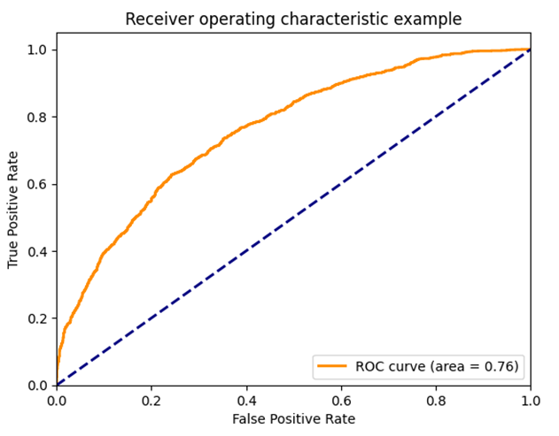
Results:
LB tope - variable
mcc :0.3823098
Accuracy: 0.70
precision recall f1-score support
negative 0.70 0.77 0.73 1783
positive 0.69 0.61 0.65 1503
accuracy 0.70 3286
macro avg 0.69 0.69 0.69 3286
weighted avg 0.69 0.70 0.69 3286
array([[1366, 417],
[ 585, 918]])

Slide 58
with Validation data : LB tope - fixed
mcc :0.50040267
Accuracy: 0.77
precision recall f1-score support
negative 0.80 0.85 0.82 1795
positive 0.71 0.64 0.67 1042
accuracy 0.77 2837
macro avg 0.76 0.74 0.75 2837
weighted avg 0.77 0.77 0.77 2837
array([[1518, 277],
[ 371, 671]])

Slide 59
Validation with AAV DATA
accuracy: 0.445621
array([[ 0, 0],
[102, 82]])
precision recall f1-score support
0 0.00 0.00 0.00 0
1 1.00 0.45 0.62 184
accuracy 0.45 184
macro avg 0.50 0.22 0.31 184
weighted avg 1.00 0.45 0.62 184

Slide 60
METHOD - 10: BERT
METHODOLOGY
Model Selection: A pre-trained BERT model (BertForSequenceClassification) was chosen for sequence classification tasks.
Training Setup: The model was fine-tuned on the training data using the cross-entropy loss function and the Adam optimizer.
Training Loop: During training, the model's parameters were updated in each epoch using backpropagation, and the loss and accuracy were recorded.
Evaluation: After each epoch, the model's performance was evaluated on the validation set without updating the model parameters.
METRICS
Accuracy score, mathews correlation coefficient ,recall, precision, f1score
ROC CURVE

Slide 61
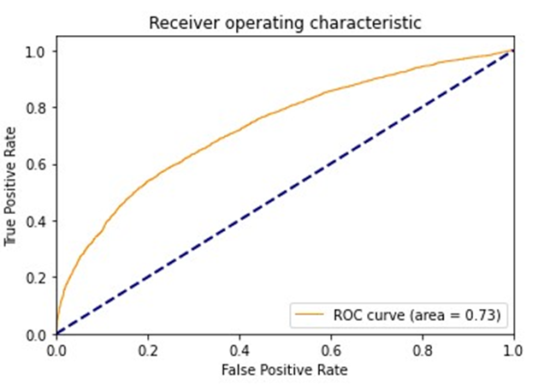
Results:
LB tope - variable
Training:
Accuracy of last epoch: 0.94059735
loss of last epoch: 0.159418595
Testing :
Accuracy of last epoch: 0.701178010
loss of last epoch: 1.02653

Slide 62
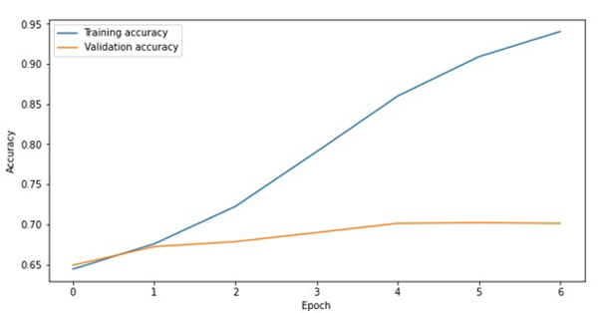
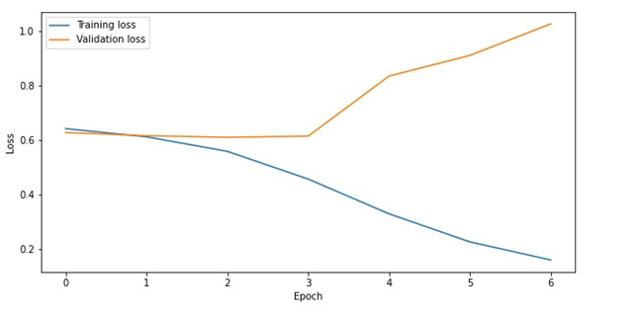
testing
-> epoch vs accuracy
testing
epoch vs loss <-

Slide 63
with Validation data : LB tope - fixed
Accuracy: 0.9407825167430
loss: 0.20065079126088
mcc :0.872104955
precision recall f1-score support
negative 0.93 0.97 0.95 1795
positive 0.95 0.88 0.92 1042
accuracy 0.94 2837
macro avg 0.94 0.93 0.94 2837
weighted avg 0.94 0.94 0.94 2837
array([[1749, 49],
[ 122, 920]])

Slide 64
Validation with AAV DATA
test loss:1.6281480888525646
test accuracy :0.5597826086956522

Slide 65
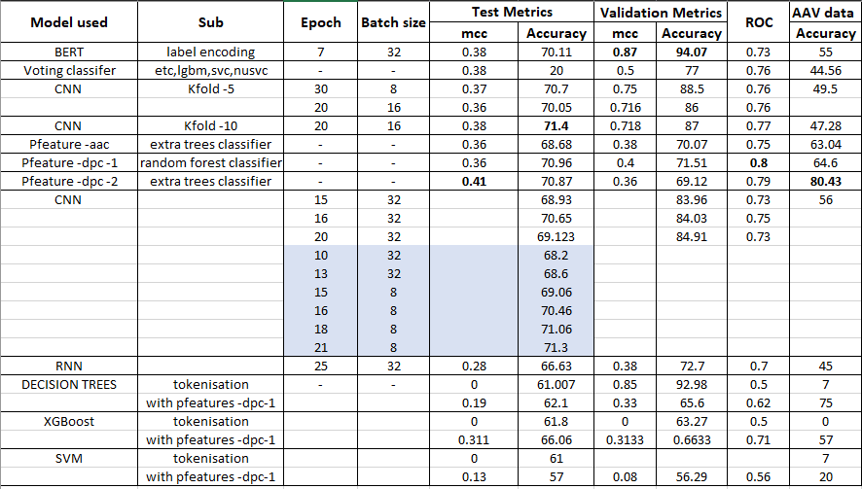
shaded region - random tries

